Slide 1
Martin Luther High School
1983-2018
Honoring Christ…Welcoming All

Slide 2
1947…The dream of a Lutheran High School began…

Slide 3
In Loving Memory
We give thanks to God always for all of you,
constantly mentioning you in our prayers,
remembering before our God and Father
your work of faith and labor of love
and steadfastness of hope in our Lord Jesus Christ.
For we know, brothers loved by God, that He has chosen you,
because our gospel came to you not only in word,
but also in power and in the Holy Spirit and with full conviction.
You know what kind of men we proved to be
among you for your sake.
And you became imitators of us and of the Lord,
for you received the word in much affliction,
with the joy of the Holy Spirit,
so that you became an example to all the believers.
1 Thessalonians 1:2-7

Slide 4
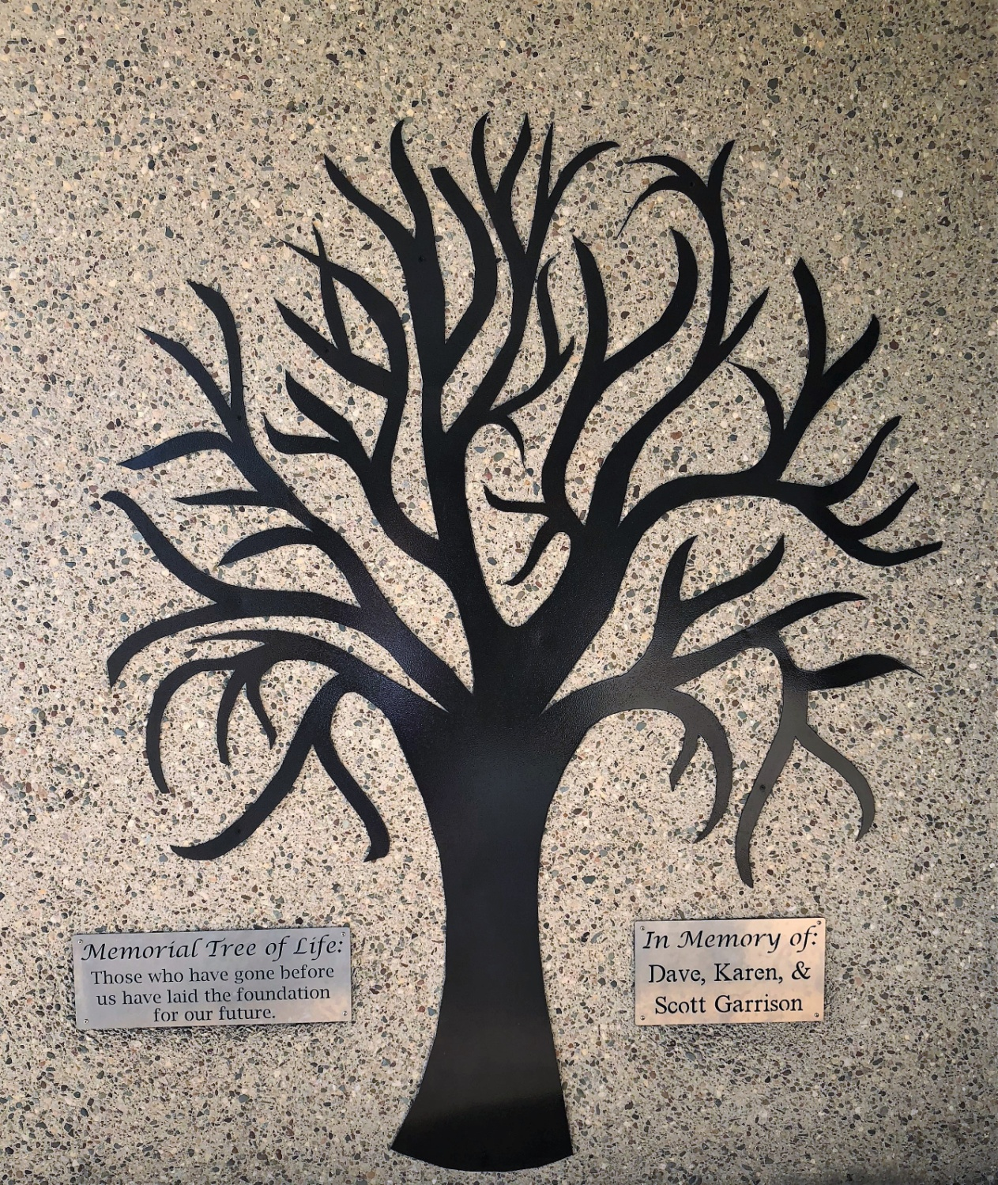

Slide 5
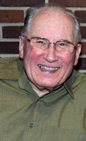
In Memory of Ervin J. Barchenger
Erv was a faithful donor, volunteer and advocate of Lutheran education and Martin Luther High School.
With Erv’s assistance, the land that is the current MLHS campus and softball diamond was purchased from the Barchenger family in 1984 and 1985 at a discounted price.
Erv also remembered MLHS with a large estate gift that was distributed after his death.
1929-2017

Slide 6
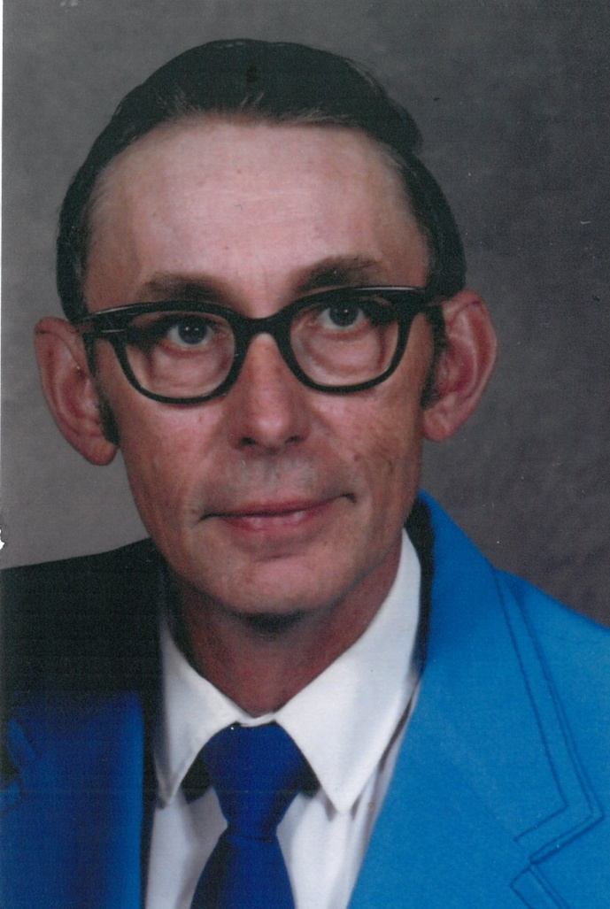
In Memory of Louis Beckendorf
Louis was committed to Christian education. He served as a Delegate from St. Paul’s, Wilbert and was on the MLHS Board of Directors from 1993-1996. His four children attended St Paul’s Lutheran Elementary School, Wilbert. There was no question in his mind that they would also attend MLHS. They all also attended college pursuing careers in agriculture. Lisa (92)-Senior Lab Technician, Eric (94)-Entomologist, Mark (96)- Agronomist, and Dale (01)-Agronomist. Grandson Dylan is in the Class of 2020.
January 28, 1934 April 4, 2001

Slide 7
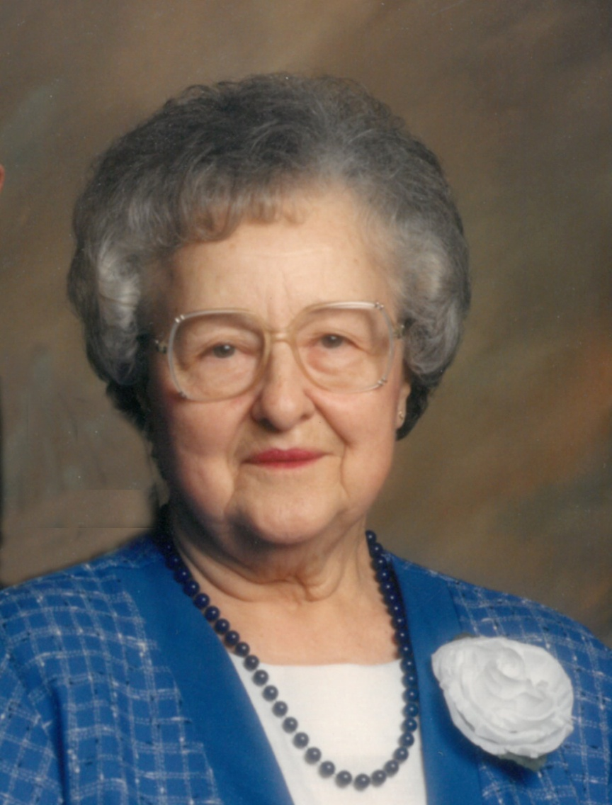
In Memory of Alma Becker
A life-long resident of the Northrop area, Alma was a devoted supporter of Christian education. Both Alma and Walter were generous supporters of MLHS from its beginning, through the building of the school and Lutheran Activity Center and in purchasing the bleachers. She was delighted when the new high school was built just east of her home and took pleasure in attending MLHS events.
1914-1998

Slide 8
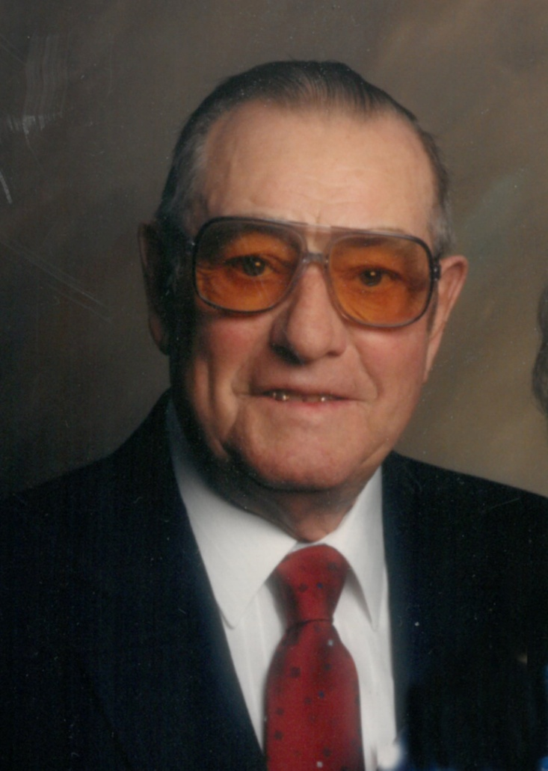
In Memory of Walter Becker
A life-long farmer, Walter generously gave of the bounties he reaped to strengthen Christian education. He was a loyal advocate of MLHS from the beginning. He treasured the opportunity to preserve the tradition of Christian education for future generations. Alma and Walter’s children were JoAnn and Larry. MLHS graduates were grandchildren Leslie (88), Lonny (89), Lynn (91) and Leah (95) and great-grandchild Leanna (08).
1914-1995

Slide 9
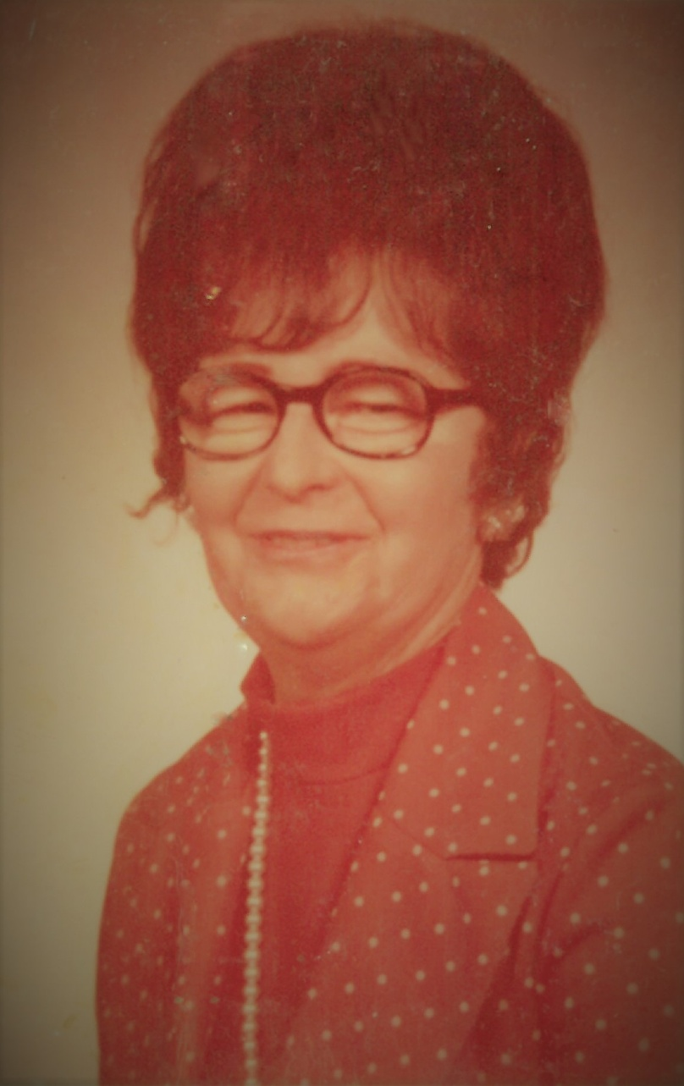
In Memory of Mary (Rieffer) Behrens
Mary was an active and vocal promoter of MLHS and a strong voice for erecting the new building.
The first year she drove her grand daughter, Teresa Behrens Kiehl, (87) to and from school every day.
Sadly, Mary didn’t live long enough to see the new, finished school building.
She was the mother of Richard Behrens, present MLHS custodian,
and great-grandmother of Kody (09) and Mason (11)
January 7, 1922
October 8, 1984

Slide 10
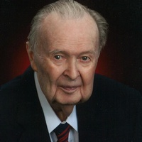
In Memory of Harold Bergt
A product of Lutheran education from elementary to college, Harold used this solid foundation to God’s glory. He devoted his life to serving as teacher and principal in Lutheran schools for 41 years. He received the Master Teachers Award from Concordia University, Seward, NE after he retired. In his retirement years, he volunteered at MLHS, served on the Board of Directors and spearheaded and managed the HyVee Gift Card fundraiser. He was pleased that five grandchildren and one great-grandchild attended MLHS.
August 1, 1920 October 29, 2018

Slide 11
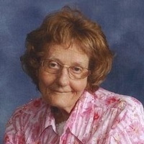
In Memory of Ruth A. Draut
Ruth grew up in the small town of Pease in northern Minnesota. She attended Pease Christian School until eighth grade. In 1958 she became well-known as the Martin County Public Health Nurse. She visited many schools attending to children. Ruth loved children and Christian education. “Martin Luther is a good school and you do good things there,” she would say. Even though she was not Lutheran, Ruth was a generous supporter of MLHS while she was living and remembered MLHS in her will.
October 16, 1932 July 20, 2018

Slide 12
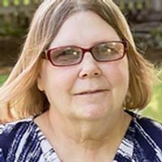
In Memory of Marlys Ehlert
Marlys had a true passion for children and provided Day Care for over 35 years. She also loved Martin Luther High School and attending her grandchildren’s events. She never missed a Grandparent’s Day Celebration.
Son-in-laws who attended MLHS were Jason Schuder (88) and Terry Mohwinkel (93). Grandchildren who graduated were Krystopher (11), Amanda (14) and Alexandra (18). Nephew Paxton will graduate in 2019.
September 5, 1950
October 16, 2016

Slide 13
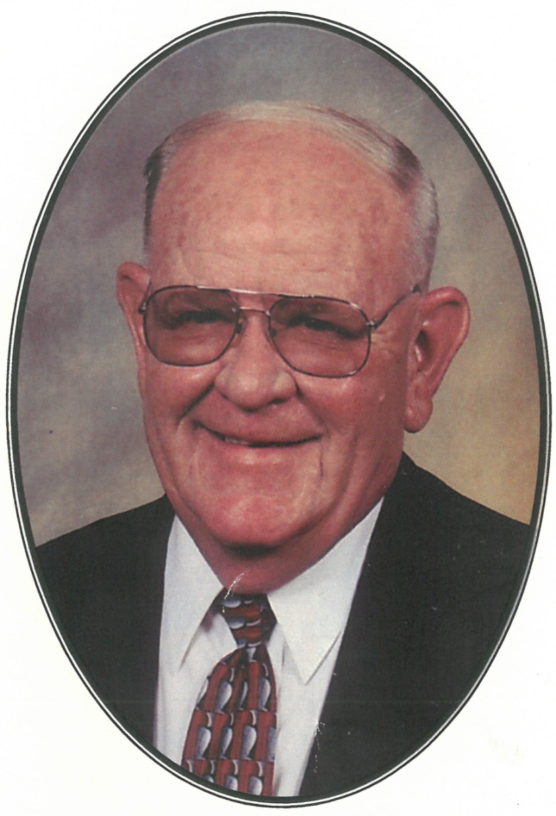
In Memory of Perlon “Perp” Engelby
Perlon was devoted to MLHS from the beginning. Son Paul, a member of the first freshman class, graduated in 1987. Perlon was always willing to help out at MLHS, whether it was fixing things that needed fixing, building things that needed building, setting up for the rummage sale, or just enjoying MLHS activities. Perlon was a regular monthly donor of the KNIGHT’S Brigade membership and Ruth continues his legacy.
September 26, 1933
January 6, 2012

Slide 14
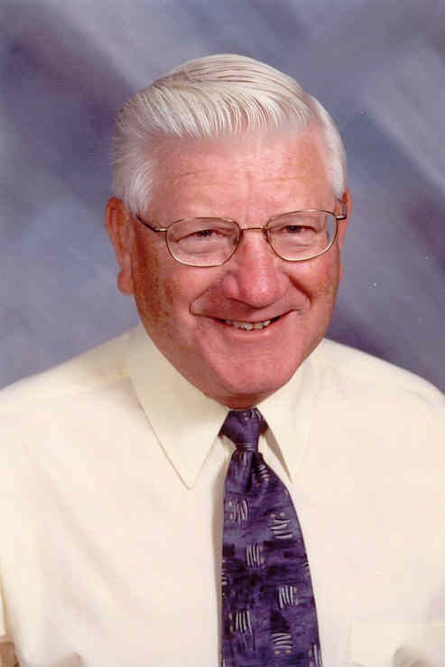
In Memory of Marvin Erdman
As Principal at St. Paul’s Lutheran, Wilbert, Marv was an ardent proponent of MLHS. His enthusiasm and faithfulness to God’s Word inspired hundreds of people. He was passionate about Lutheran education for all ages. He loved music, sports and Chryslers. In his retirement he enjoyed teaching Old Testament Religion at MLHS.
Marv umpired many games with son, Joel, (89).
December 25, 1935
August 1, 2012

Slide 15
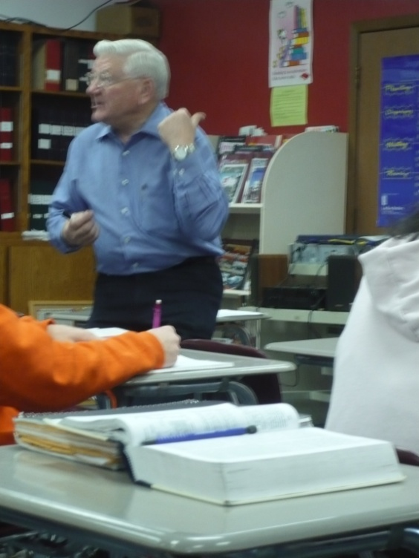
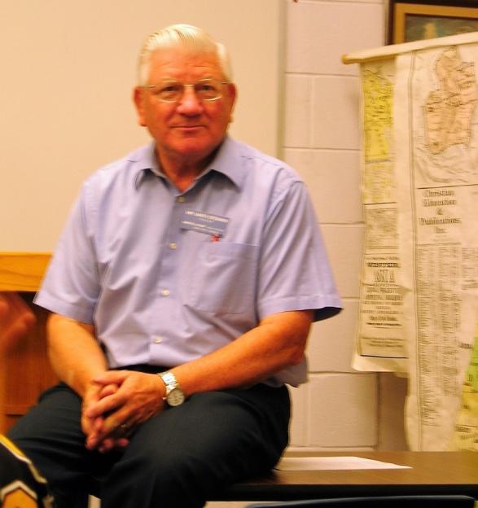
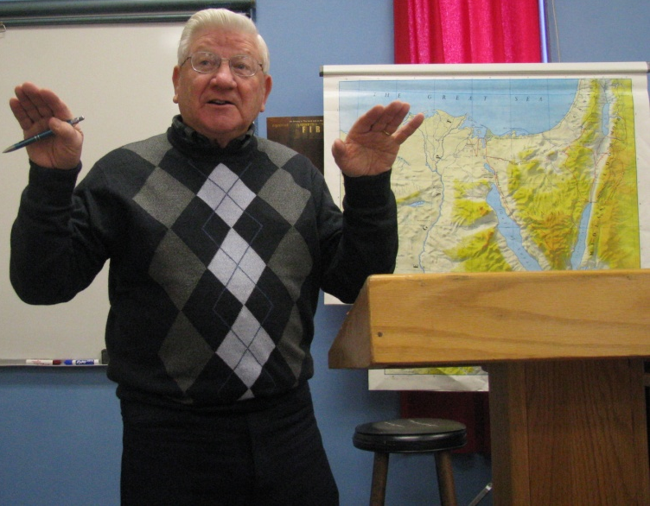
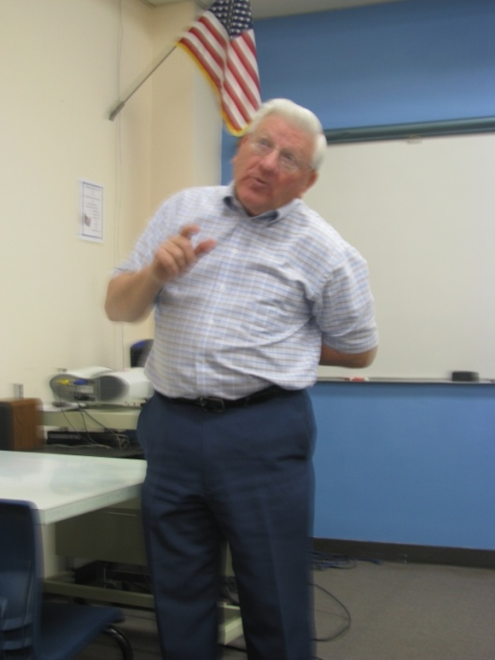
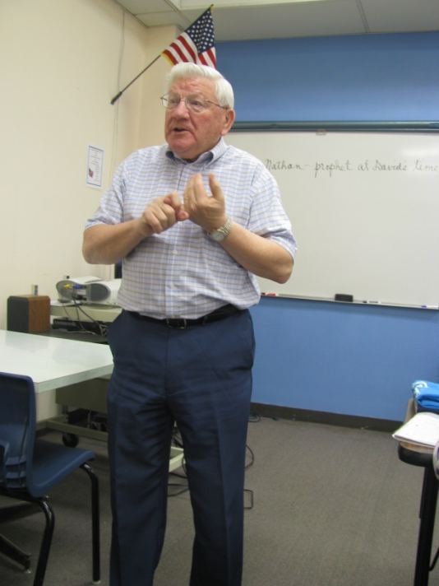
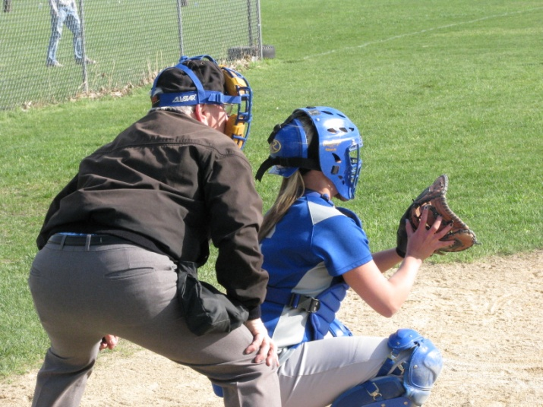

Slide 16
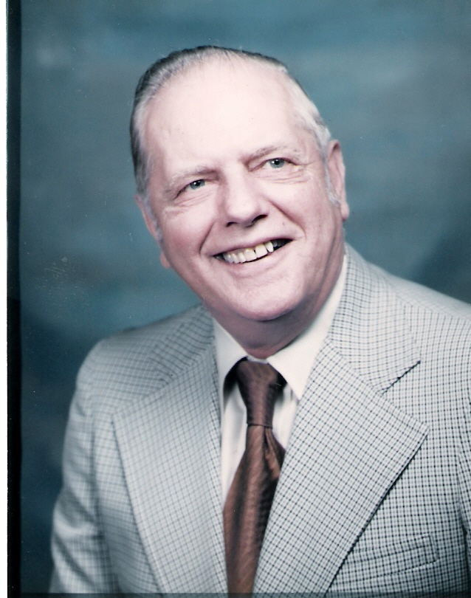
In Memory of Alvin Fanter
Alvin was a member of the Board of Regents of the Lutheran Education Association in 1955. He was also one of the co-signors on the bank note to finance the purchase of the land in Fairmont.
An advocate of Lutheran education, he also was a long-time school board member at St. Paul’s Lutheran School, Wilbert.
He was the father of Marge Thiesse, grandfather of Faith (95), Lynn (97), Angela (00) and great-grandfather of Michaelah Petrowiak (21).
July 29, 1917
April 1, 1993

Slide 17
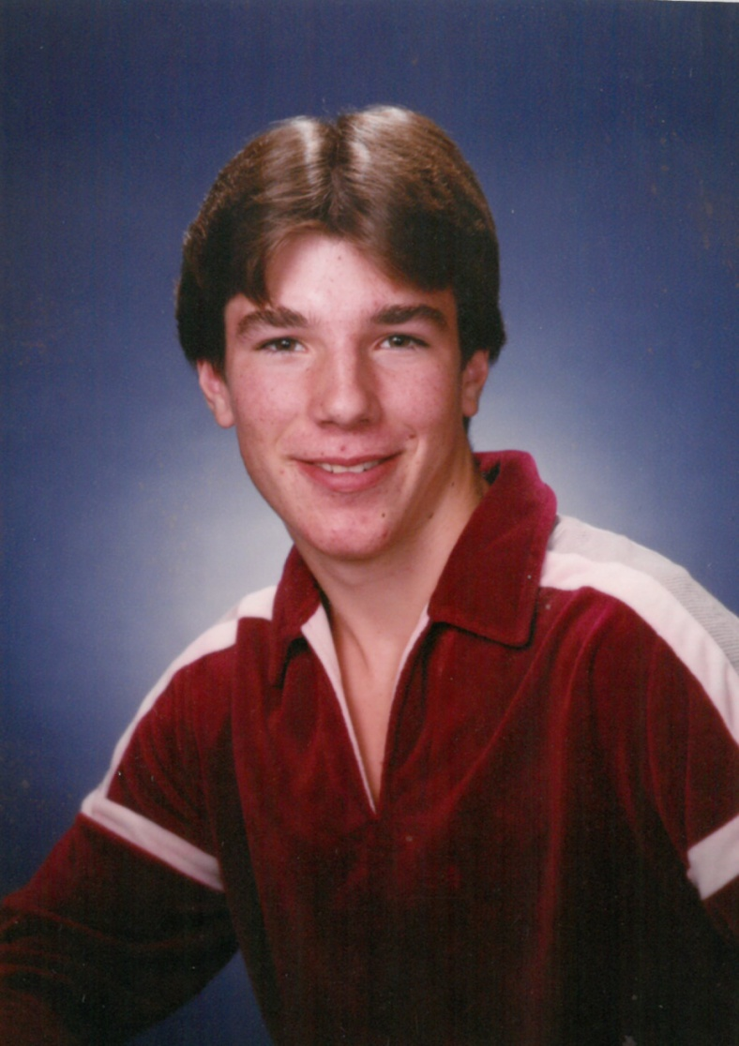
In Memory of Scott Garrison
Scott entered MLHS as Sophomore and one of the original 19 students. The transition was a little tough for him, but he jumped right in to MLHS life. He was Class President and Captain of the Basketball Team. He also played Legion baseball and was active in 4-H. He was killed in a farming accident in the summer prior to his Junior year. The Lutheran Activity Center was dedicated in his memory and his basketball jersey was retired.
1968-1984

Slide 18
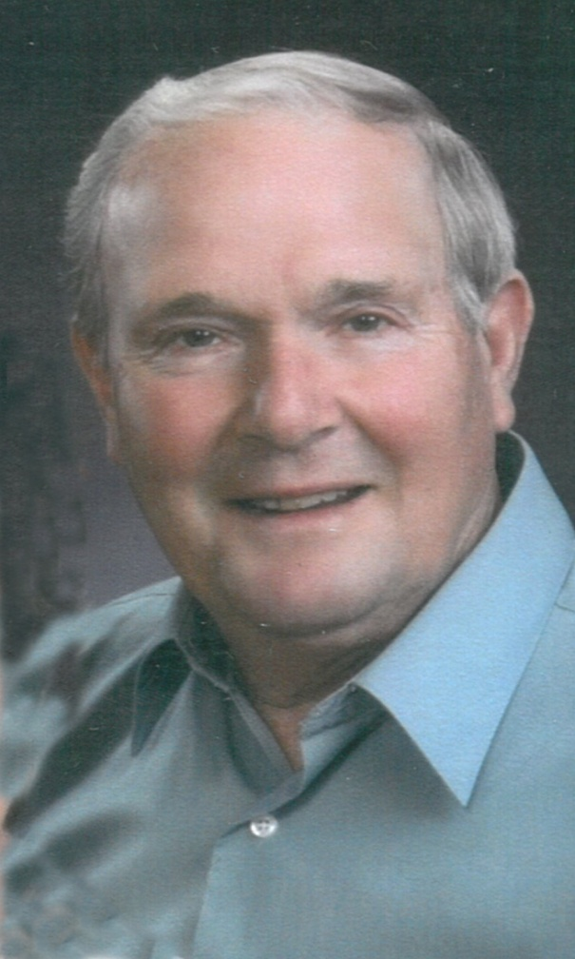
In Memory of David Garrison
Dave Garrison enjoyed life to the fullest. He was a strong man of faith and treasured his family. He was actively involved in the growth of MLHS from the beginning. While losing son Scott in a farming accident was difficult, both Dave and Karen were at peace with choosing MLHS for Scott, knowing his faith was strengthened here.
Dave and Karen were members of the KNIGHT’S Brigade and remembered MLHS with an estate gift.
1939-2014

Slide 19
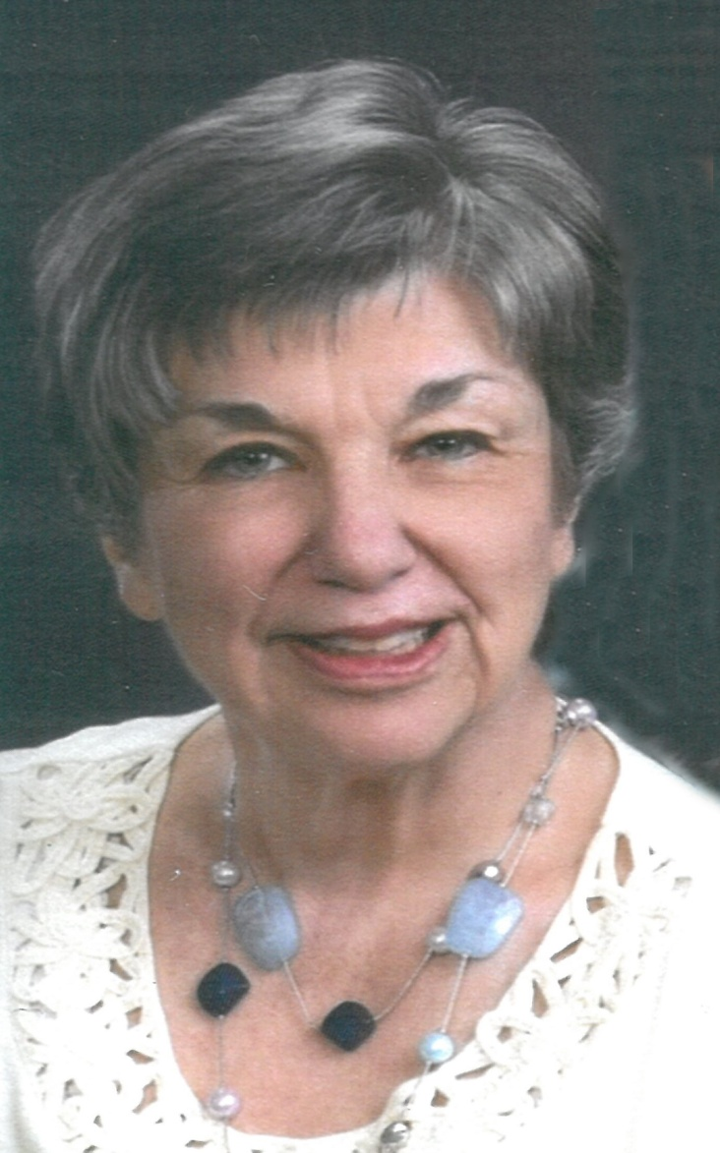
In Memory of Karen Garrison
Karen’s quiet, gentle spirit was a living witness of her strong Christian faith. Before marrying Dave, she was Lutheran teacher at St. Paul’s, Wilbert. Her devotion to Lutheran education for all ages was exemplified in her words, giving and volunteerism. Son Tyler graduated in 1991. She was delighted when grand-daughter Katie (18) enrolled at MLHS.
April 7, 1941
December 11, 2016

Slide 20
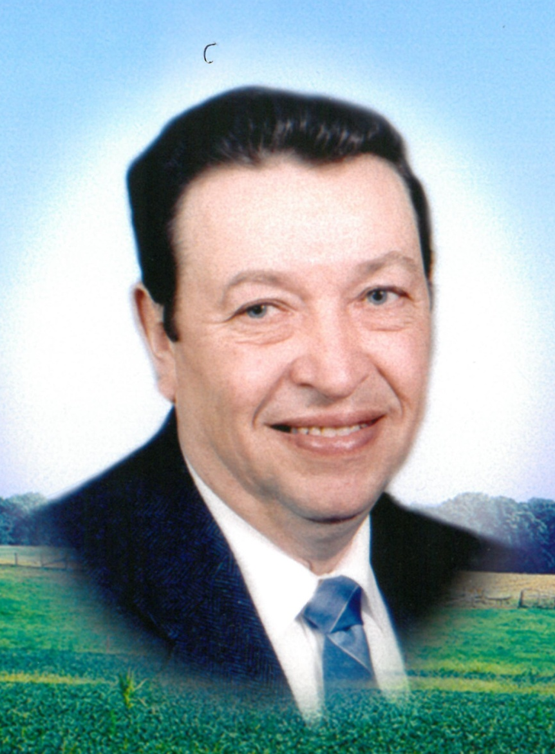
In Memory of Roger Geistfeld
Former member of the MLHS Board of Directors and strong Christian leader.
Father of: Melissa (86),
Bruce (88), Jonathan (90).
Grandfather of: Cody (10), Andrew (11), Haley (11), Sam (14), Christina (14), Hanna (17), Sierra (19), Mallery (22), Mariah (22) and Harley (25).
Roger’s wife, Linda, continues to support MLHS in many ways.
September 5, 1935
January 27, 2000

Slide 21
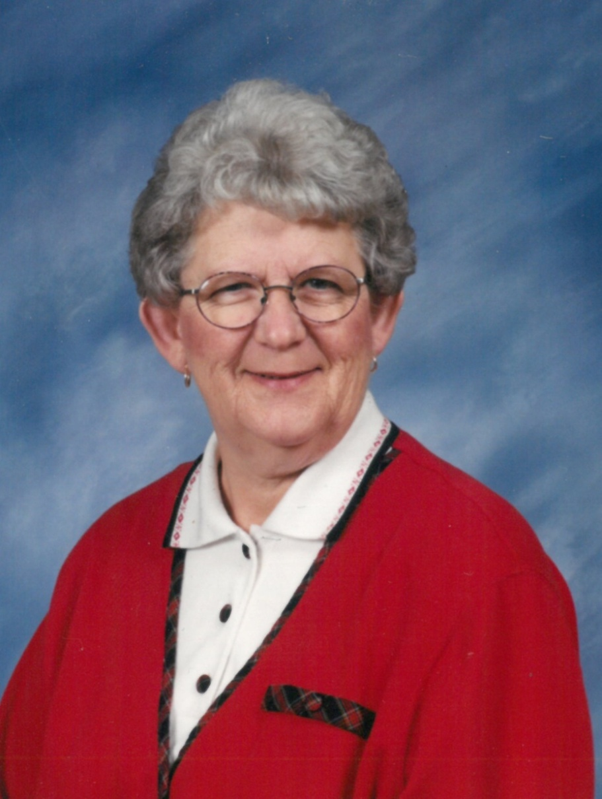
In Memory of Janice (Meyer) Goebel
Janice and her husband, Marvin, believed in Lutheran education. She was a faithful volunteer at both St. Paul Lutheran School, Fairmont and MLHS. Their daughters Debra (89) and Karen (90) attended MLHS. Janice continued volunteering at MLHS for many years after they graduated.
1941 - 2015

Slide 22
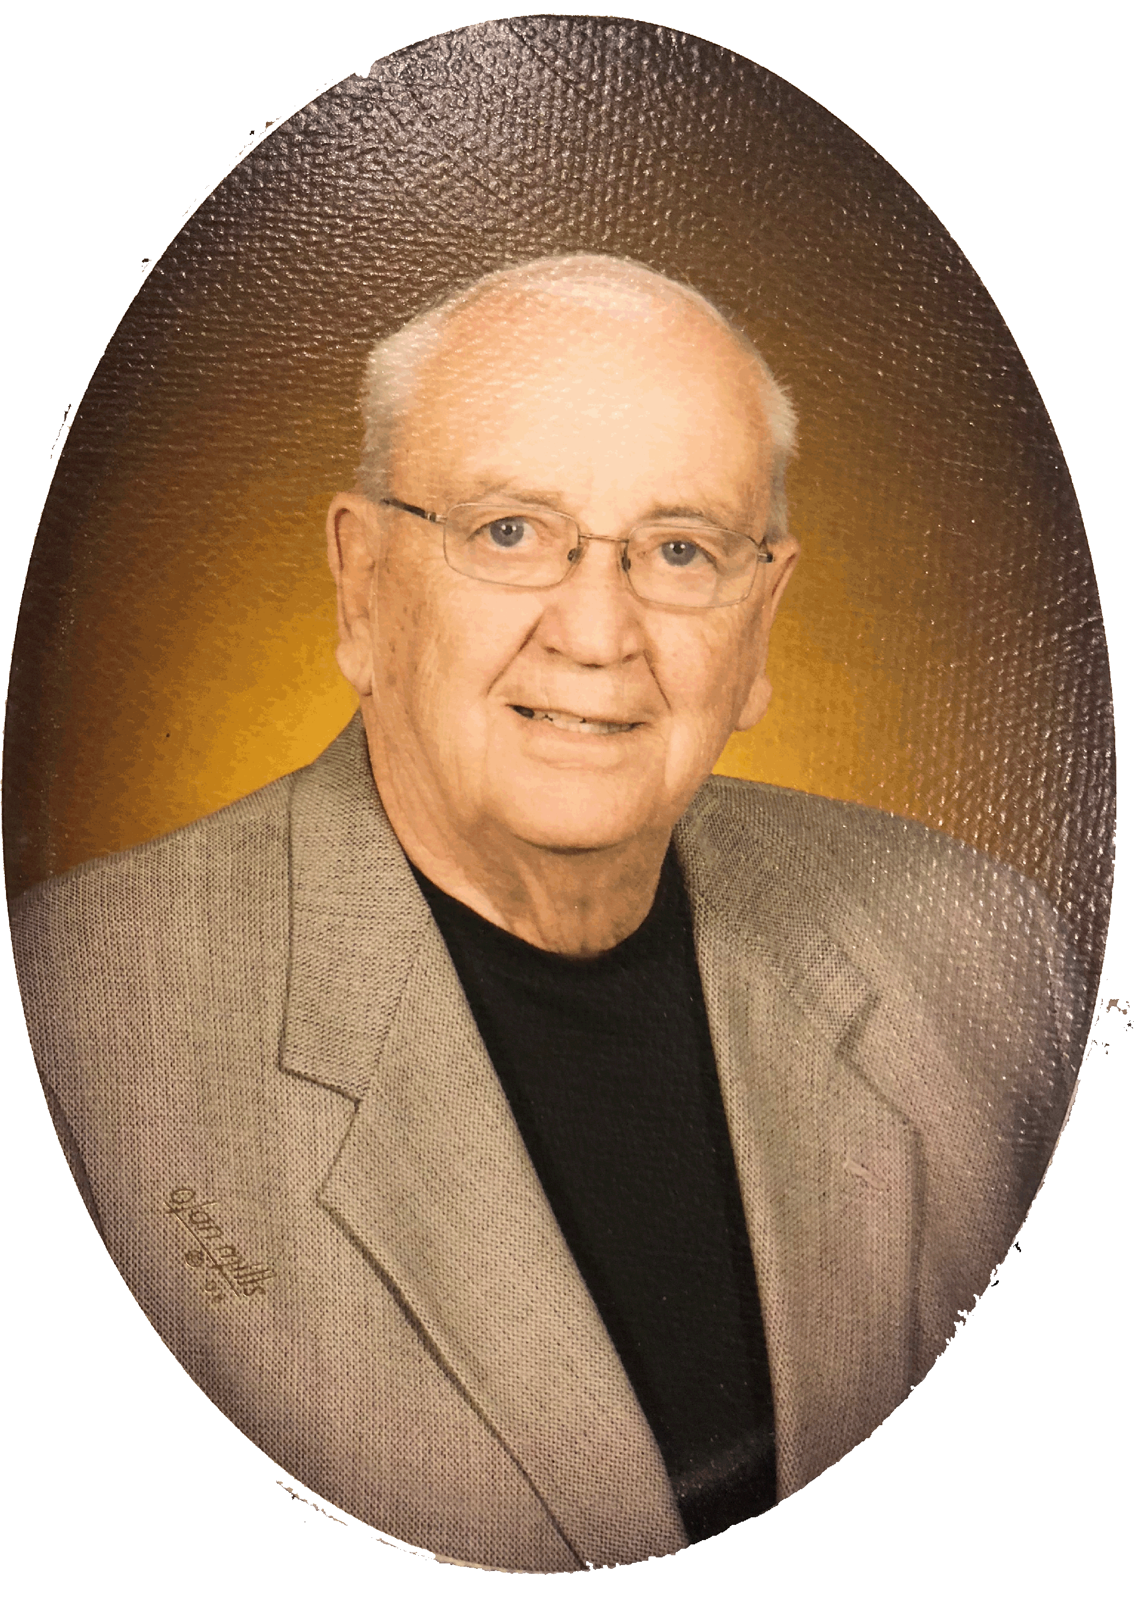
In Memory of Chuck Groth
Due to Chuck's job, his family moved many times. They were not able to live in a location where their children could attend a Lutheran school. While disappointed the children were never able to go to a Lutheran school, moving to Fairmont changed that, Chuck and Kay were glad to have the opportunity to volunteer at MLHS. Chuck believed in supporting God’s Ministries. He was active in the LLL and the Lutheran Hour Ministries, was an MLHS Delegate from St Paul, Fairmont and served on the MLHS Board of Directors from 2008 until his death.
1934-2011

Slide 23
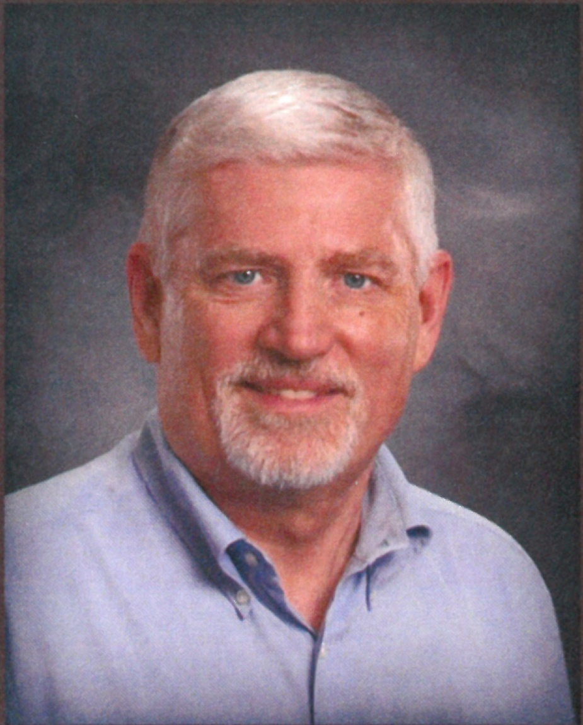
In Memory of Robert Hall
Robert was a big proponent of Christian education. He was honored to serve as the first President on the Board of Directors at MLHS. Both Bob and his wife, Pat, were instrumental in getting the school up and running in 1983. They remained involved after children Heather (88) and Ryan (90) graduated. Grandchildren who were/are MLHS students are Andrea (14), Tyler (15), Jordan (20) and Alyssa (22).
March 19, 1946
September 26, 2015

Slide 24
In 2014 Principal Steinhaus and Robert Hall recorded an “Our Story Making a Difference” video about the history and purpose of the MLHS Ministry. It can be viewed at www.martinlutherhs.com and on YouTube.

Slide 25
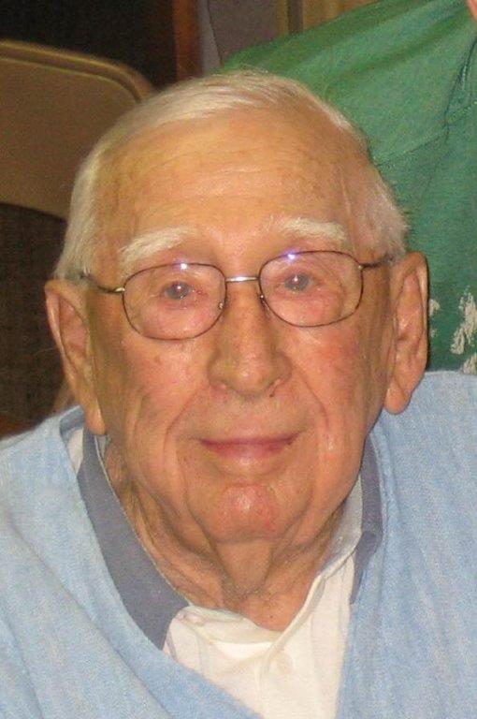
In Memory of Luverne “Herky” Halverson
Luverne "Herky" Halverson was proud knowing all his grandchildren would attend MLHS. He showed support by attending as many fundraisers as able, especially the auctions which he thoroughly enjoyed.
Grandchildren who are MLHS graduates are Hayley (Koeritz) Luther (09), Mason Koeritz (13), Lindsey (Halverson) O’Loughlin (99) and Lance Halverson (05).
1921-2008

Slide 26
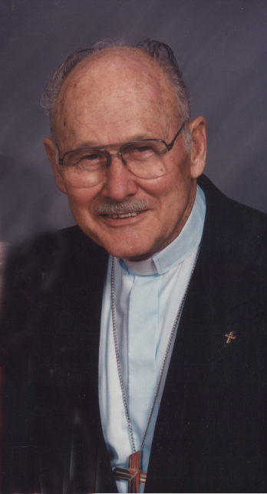
In Memory of
Rev. Vernon Harley
Rev. Vernon H. Harley
August 4, 1917-June 4, 2006
Rev. Harley was loyal supporter of Lutheran education for all ages. He served at St. Paul Lutheran Church and School, Fairmont from 1964 to 1987. He taught German, Spanish and Religion at MLHS and was a strong spiritual leader there for many years. Both Rev. and Mrs. Harley gave generously of their time, talents and treasures to grow God’s Ministries.

Slide 27
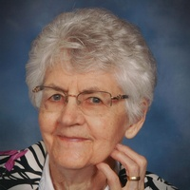
In Memory of Luverna Hartmann
Luverna, and her husband Wilbert, were faithful supporters of the MLHS Ministry. They both volunteered with KnightLight mailings and helped with the rummage sale. They loved attending MLHS events and giving to the school. Luverna remembered MLHS in her estate plans and designated that her memorials be directed to the school.
February 21, 1921
August 31, 2018

Slide 28
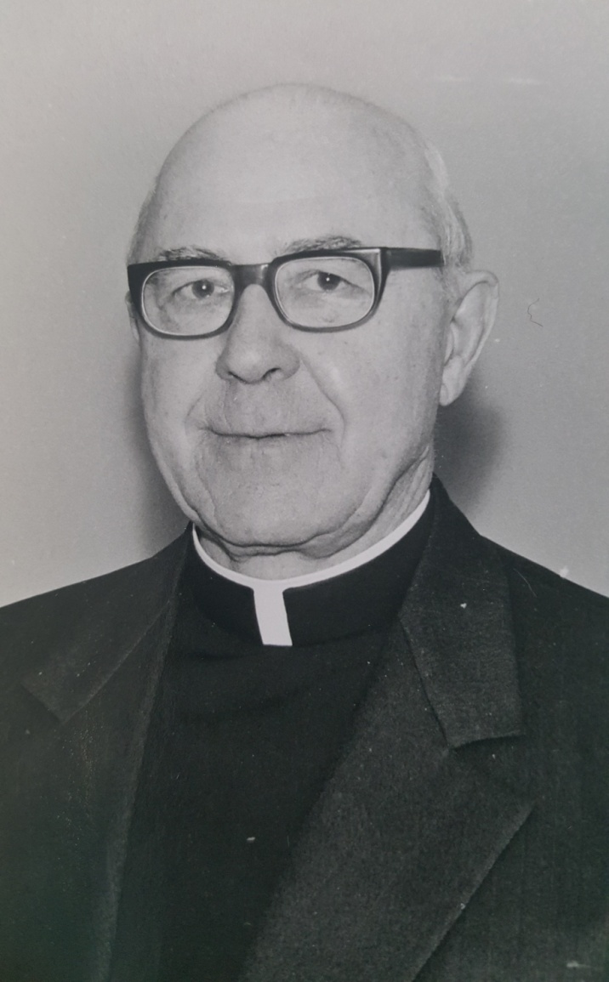
In Memory of Rev. Otto F. Hinrichs
Rev. Hinrichs served as pastor at St. Paul’s Lutheran Church , Truman from 1951 to 1974. He was a voice of leadership in support of Lutheran schools. Rev. Hinrichs was a member of the Lutheran Education Association Board of Regents who signed the articles of incorporation in 1959. St. Paul’s Lutheran Church and School purchased a Memory Leaf in his memory.
1905-1991

Slide 29
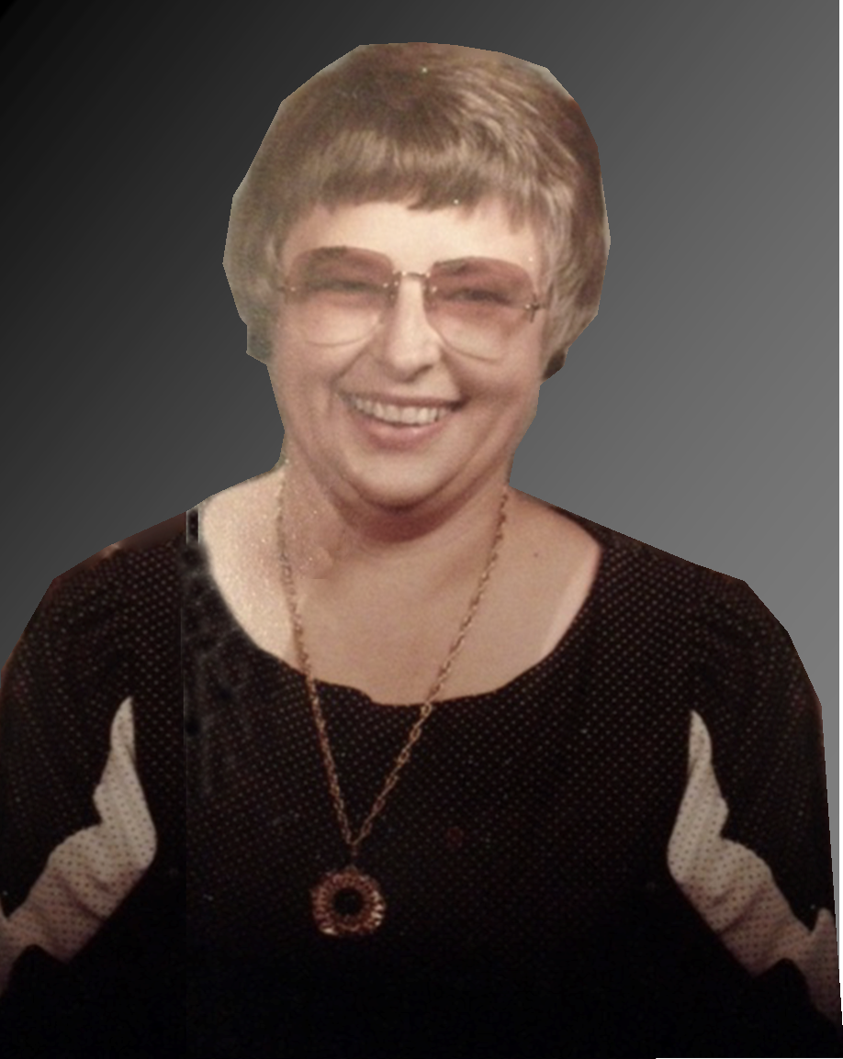
In Memory of Loretta Hintz
Loretta Hintz was a bubbly, kind lady who made everyone around her feel happy. When daughter Naomi (90) attended MLHS, Loretta worked in the concession stand, helped with rummage sales and assisted wherever needed. Unfortunately, she left us before she could delight in having her grandchildren attend MLHS. Leimer children: Tom (01),
Katie (05) and Joe (08); and Bremer girls: Leslie (04), Elizabeth (07), Aly (11).
1934-1991

Slide 30
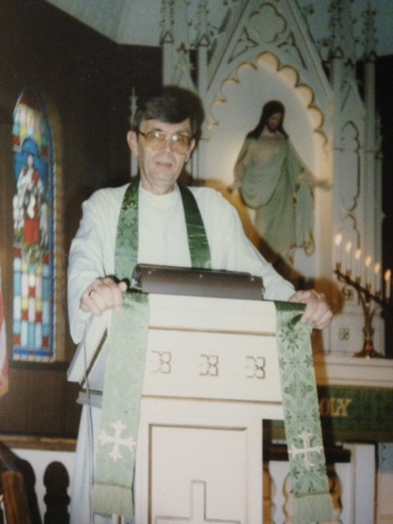
In Memory of Rev. Robert Hintz
Pastor Hintz first began his church work career as a Lutheran school teacher. As pastor at St. Paul’s, Wilbert he strongly supported their church’s school and MLHS. He served on the MLHS Board of Directors from 1985-1987. He was a vocal fan at athletic contests. In 1991 he donated funds toward the new bleachers for the Lutheran Activity Center in memory of his wife, Loretta.
1931-1999

Slide 31
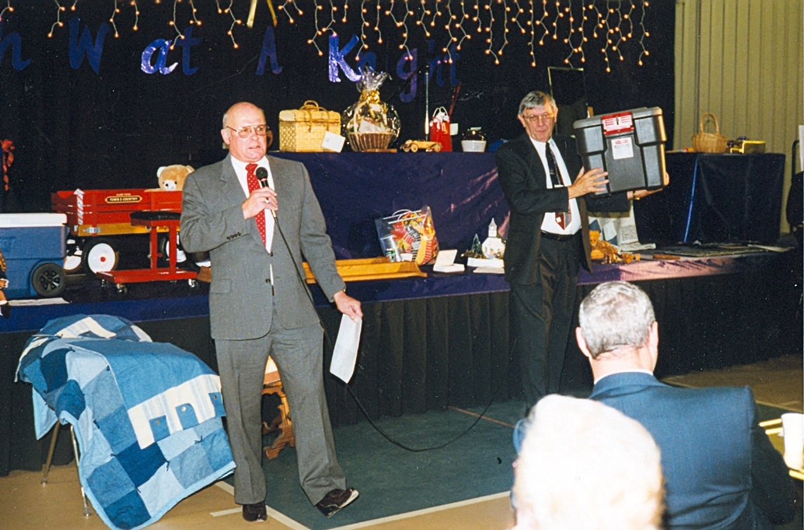
Rev. Robert Hintz (right) emceed the OH! What a KNIGHT Dinner Auction with Allen Kahler for many years.

Slide 32
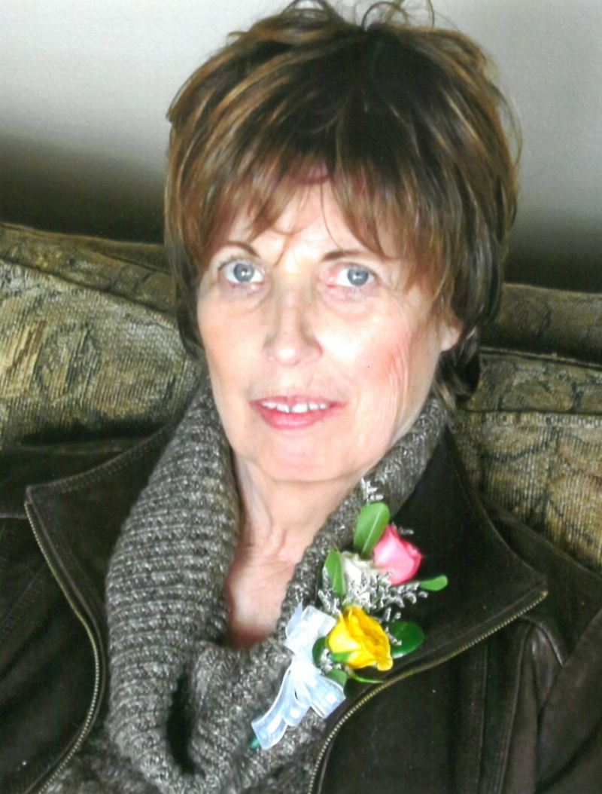
In Memory of Cindy Klug
Cindy’s soft spoken ways were
a representation of her faith life.
Always ready with a smile and kind words, her support of MLHS was carried out faithfully and quietly.
She enjoyed the “Generation to Generation” Antique Auction.
Cindy and her husband, Ken, have been long-time members of the KNIGHTS Brigade, supporting MLHS on a monthly basis.
All of their children attended MLHS. Matt (00), Jessica (02)
and Brandon (05).
February 18, 1954
July 5, 2018

Slide 33
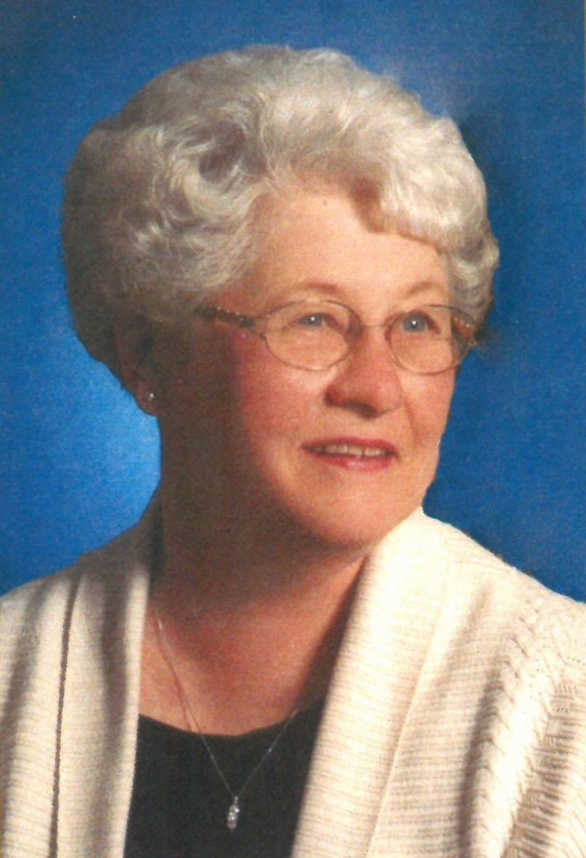
In Memory of Virginia Krause
Virginia was a strong voice for Martin Luther High School. She not only encouraged others to choose MLHS, she was a devoted volunteer and a generous giver. Since the beginning, Virginia worked at every Rummage Sale but one. During the winter she would sort rummage jewelry, make repairs and get it ready for the next sale. She also made a beautiful jewelry Christmas tree for the Dinner Auction. Since Day One she worked hard for, promoted, and supported the MLHS Ministry. A loving mother to many, MLHS graduates were Jeannine (90) and Joel (88).
May 8, 1937
September 29, 2016

Slide 34
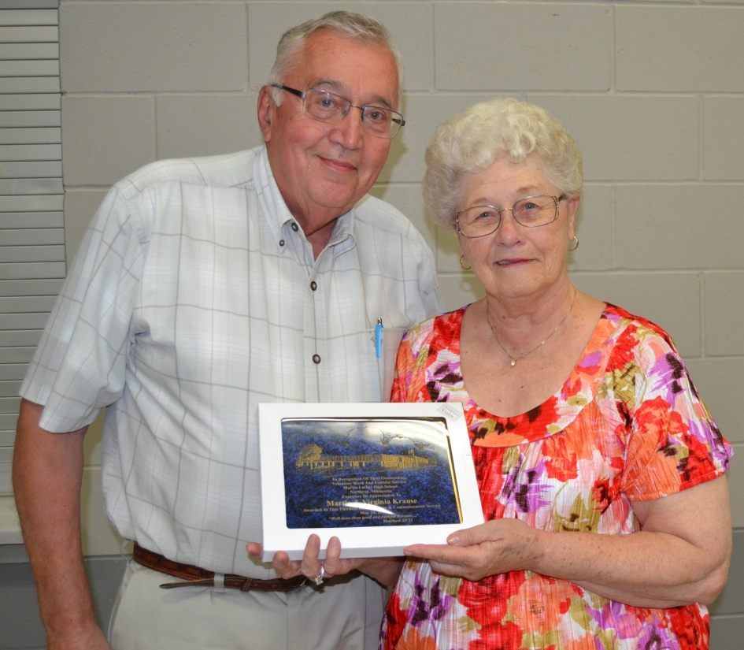
Virginia and Marty organized the Benefit Dinner for many years. They offered many large Challenge Matches to attendees to raise funds for Student Tuition Aid. They also were Guardian Angel scholarship donors helping many students attend MLHS.
One of Virginia’s life wishes was to leave a lasting legacy that would help young people attend MLHS well into the future. Upon her death, Marty established The Virginia and Martin Krause Scholarship Fund. This fund awards thousands of dollars each year to several qualifying applicants.

Slide 35
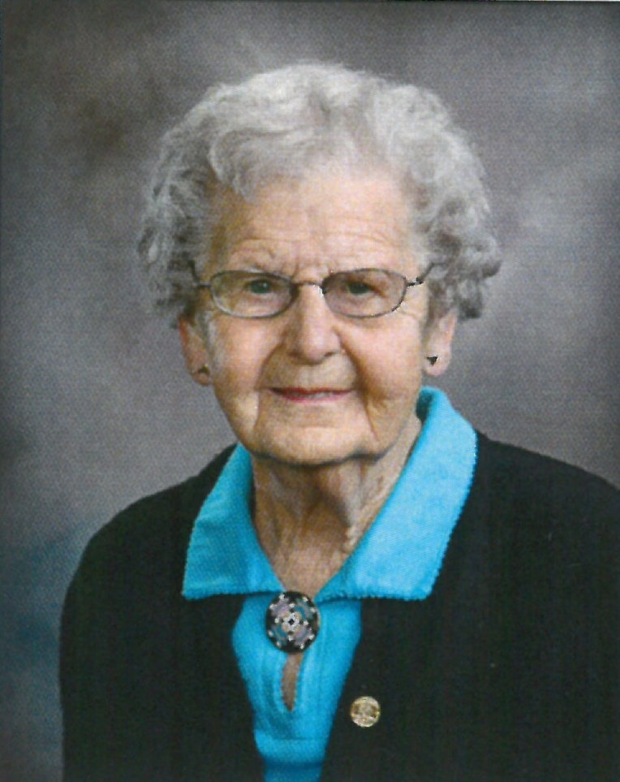
In Memory of Elda Leiding
As a child, Elda attended St. Paul Lutheran School in Wilbert. As an adult, she was a dedicated, hardworking wife and mother. Elda was faithful to St. Paul’s Lutheran Church and School in Fairmont and to Martin Luther High School. She was a regular volunteer, attended fundraising events and was a monthly donor in the “Faith for the Future” Membership. Grandchildren who were MLHS graduates were Tracy (90), Leah (97), Inga (99) and Sam (02).
March 2, 1919
January 10, 2015

Slide 36
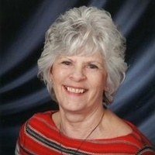
In Memory of Joyce (Meyer) Maschoff
Joyce had a passion for life and loved keeping busy. She polished her God-given talents to develop her business “Crafts of Joy” and donated hand-made items to the MLHS Dinner Auction. In 2015 she designed and made the new MLHS Knights Banner. Working as a helpmate with her husband Eldean, the couple loved gardening and donated asparagus to the MLHS auction also. When she passed away she requested memorials be directed to MLHS.
June 17, 1946
May 5, 2018

Slide 37
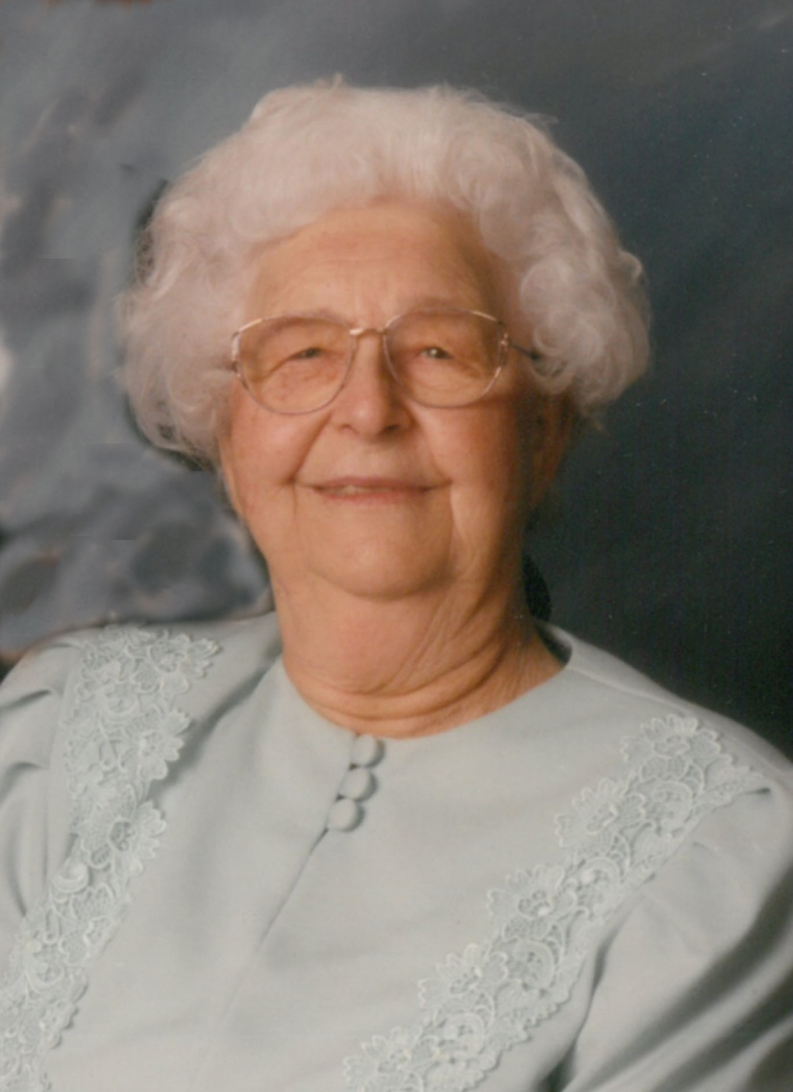
In Memory of Milda Maschoff
As a child, Milda attended St. Paul’s Lutheran School, Wilbert. She, too, was a strong supporter of Lutheran schools. She loved making handmade items and talking with her egg customers. She donated many eggs to the MLHS sales. Edwin and Milda’s children were Marlo, Eldean, Glenys and Linda. MLHS graduates were grandchildren Leslie (88), Lonny (89), Lynn (91) and Leah (95) and great-grandchild Leanna (08).
1914-2000

Slide 38
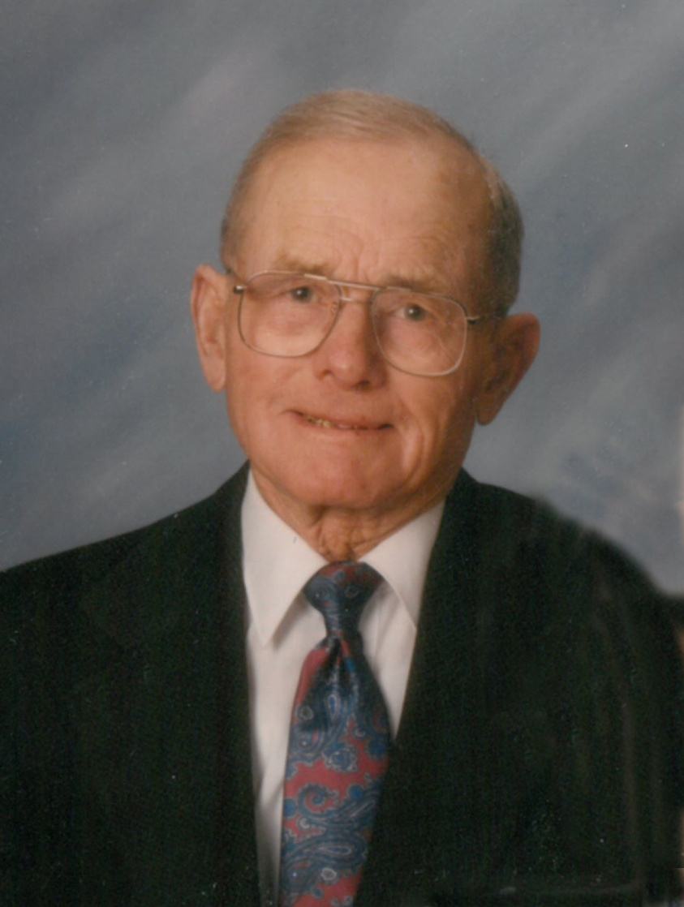
In Memory of Edwin Maschoff
Edwin was born and raised in southern Illinois. As a young man who lived through the Depression, he understood the value of faith and family. When he came to Minnesota, he met his wife Milda, and they spent their married life farming west of Northrop. He was a generous supporter of MLHS from the start and willingly shared what God gave him. His homemade pies sold for several hundred dollars at the MLHS Dinner Auction—much to his humble delight.
1906-2004

Slide 39
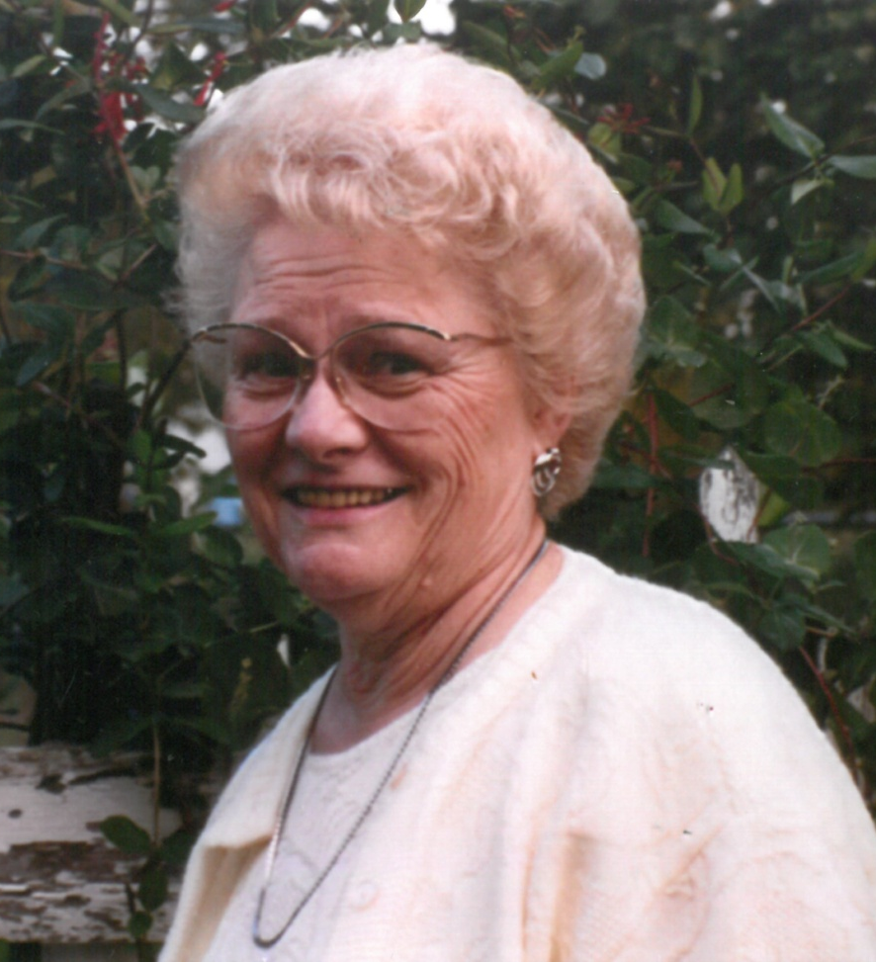
In Memory of Esther Mohwinkel
Esther loved learning. Even though she never saw her dream of earning a high school diploma come true, that never stopped her from working to ensure it would become a reality for others less fortunate. It was with great pride that she helped with rummage sales, hosted a table at the Tour of Tables and opened her home for the Christmas Tour of Homes. When she went to her heavenly home, her family set up the Esther Smith Mohwinkel (nee Kosbab) Student Tuition Aid Endowment Fund which provides tuition aid to students every year.
December 18, 1922 September 22, 2011

Slide 40
In Memory of Coach David Oothoudt
Dave was an enthusiastic fan who attended most of the girls volleyball, basketball and softball games in recent years. He also volunteered as softball coach and worked hard to upgrade the diamond.
His faith, zest for life and passion for young people left an indelible impression on many.
He was the uncle of
Lizzie (20).
1953-2018

Slide 41
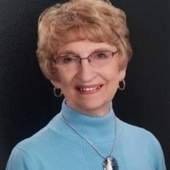
In Memory of Sherron Quiring Pullen
Sherron set countless boys and girls on the path to knowing Jesus as their Lord and Savior as a kindergarten teacher at St. Paul’s Lutheran School, Fairmont. She loved her students and sharing God’s Word with them. She was a woman of God, who left a beautiful legacy of love and faith.
Sherron and Del were strong supporters of MLHS and were thrilled to open their home for the MLHS Christmas Tour of Homes in 1999.
When Sherron passed away, the family requested that her memorials be directed to MLHS.
Their daughter Nancy graduated from MLHS in 1988
June 29, 1933 April 16, 2018

Slide 42
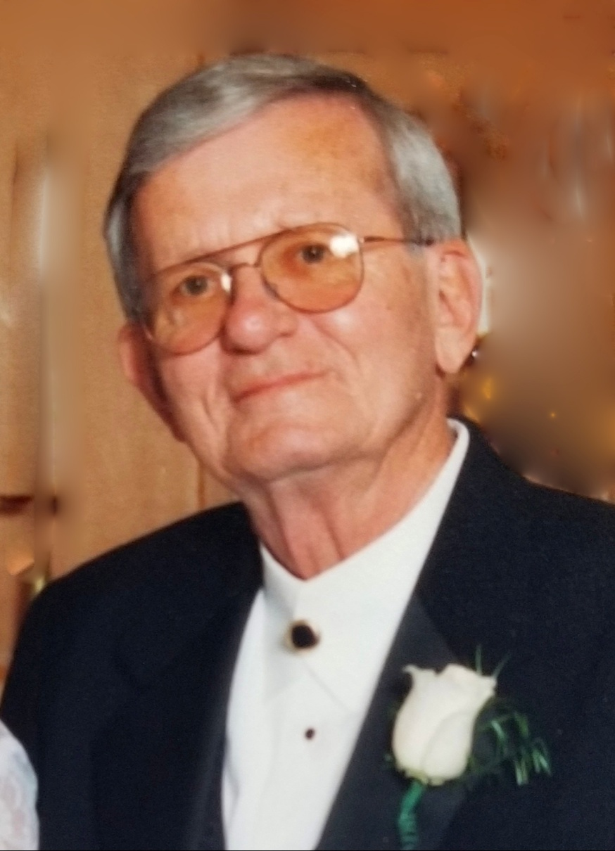
In Memory of Del Quiring
Del Quiring (father of Nancy ‘88) wholeheartedly supported MLHS, and always treasured the great times he had with the parents and students at MLHS. Del was friendly to everyone and loved to invite Nancy’s high school friends over for his special stew recipe! He and his wife Sherry were a team, volunteering at many school events. He was a wonderful, funny,
well-loved man who is missed by many. When Del passed away, the family requested all memorials be sent to MLHS.
Nov. 10 1932 May 29, 2004

Slide 43
In Memory of Rev. Dr. Lyle D. Rusert
Rev. Rusert attended a Lutheran school, continuing on to become a pastor. His grandchildren who attended MLHS are Kristin Halverson (04), Joshua (06), Julia (06), Robyn (09), Timothy (09), Jonathan (11), and Rebekah (15) Rusert.
His commitment to Lutheran teaching The Faith is written upon his tombstone
in Jesus’ Words:
“I have given them Thy Word.”
(John 17:14)
February 25, 1927 June 24, 2004

Slide 44
In Memory of Herbert A. Schroeder
Herbert was a member of the Board of Regents of the Lutheran Education Association and original signor of the articles of
incorporation in 1959.
He was great-grandfather of Brian Rosburg (02), Stephanie Rosburg (03) and Austin Berkland (19)
and great-great grandfather of
Trevor Rosburg (22).
1901-1989

Slide 45
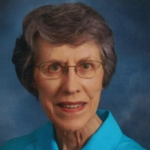
In Memory of Lois Swenson
Lois and her husband Don were both quiet supporters of MLHS. They served as Guardian Angel tuition donors for many years. Lois was a regular attendee at the Fall Benefit Dinner. Lois and Don were monthly supporters in the 25/25/25 and the KNIGHT’S Brigade for ten years.
They remembered MLHS in their estate plans. Lois requested that gifts given in her memory be directed to MLHS.
October 21, 1931
August 31, 2018

Slide 46
In Memory of Donald Swift
Don was a forefront leader in founding a Lutheran high school in southern Minnesota. He was an active member of the Lutheran Education Association and a member of the first MLHS Board of Directors. Don was the owner of Swift Systems, Northrop which was the builder of the school and gymnasium. One of Don’s biggest thrills was when the Board was given the “go-ahead” to call an administrator. Grandchildren who graduated are Derek (98), Ryan (01), Sarah (04), Hannah (06).
1930-1985

Slide 47
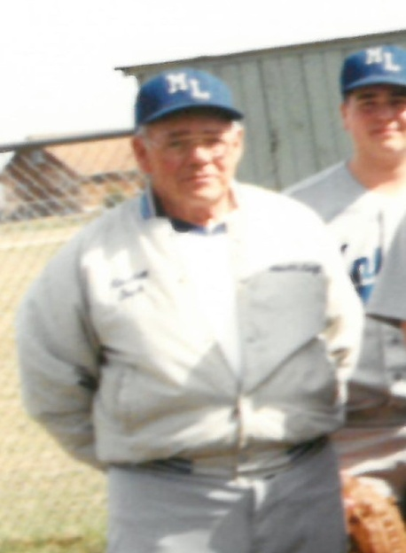
In Memory of Harold Swift
An avid sports fan, Harold spent numerous hours devoted to the MLHS Knights athletic programs. He coached baseball for several years and was a frequent visitor at the school. His strong faith, love for young people, and devotion to excellence made him an unforgettable role model to MLHS students and the first recipient of The Martin Luther Award in 1989. The Baseball Diamond in Northrop is named in his memory.
1928-2008

Slide 48
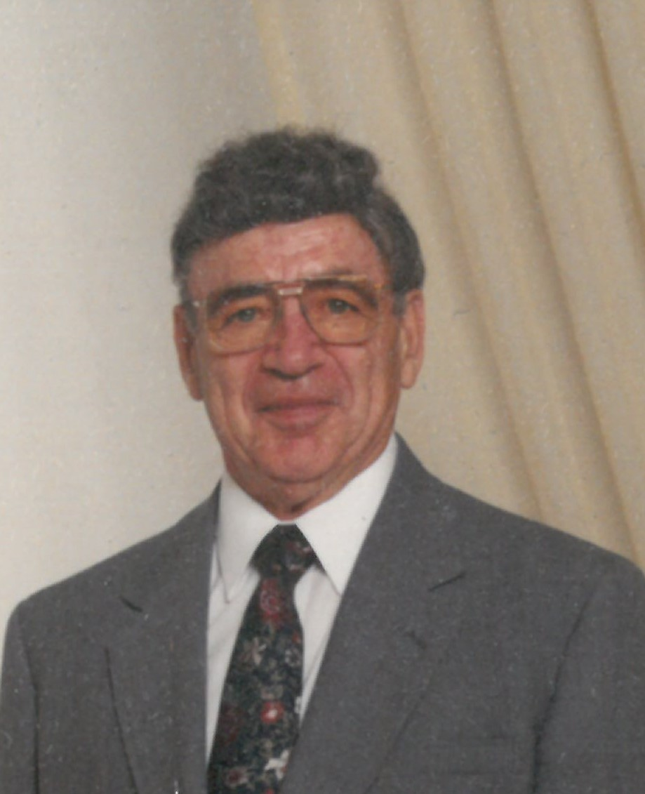
In Memory of Duane Uttech
Duane Uttech was a staunch advocate for Christian Education provided by Lutheran schools. He believed that it was an important mission and responsibility of the church. He was instrumental in the formation of St. Mark's Lutheran School in Wausau, Wisconsin. He also supported and provided service for schools and churches in central and northern Wisconsin. This was accomplished through the two Christian bookstores he and his wife, Diane, started and owned in the Wausau area.
1928-2005

Slide 49
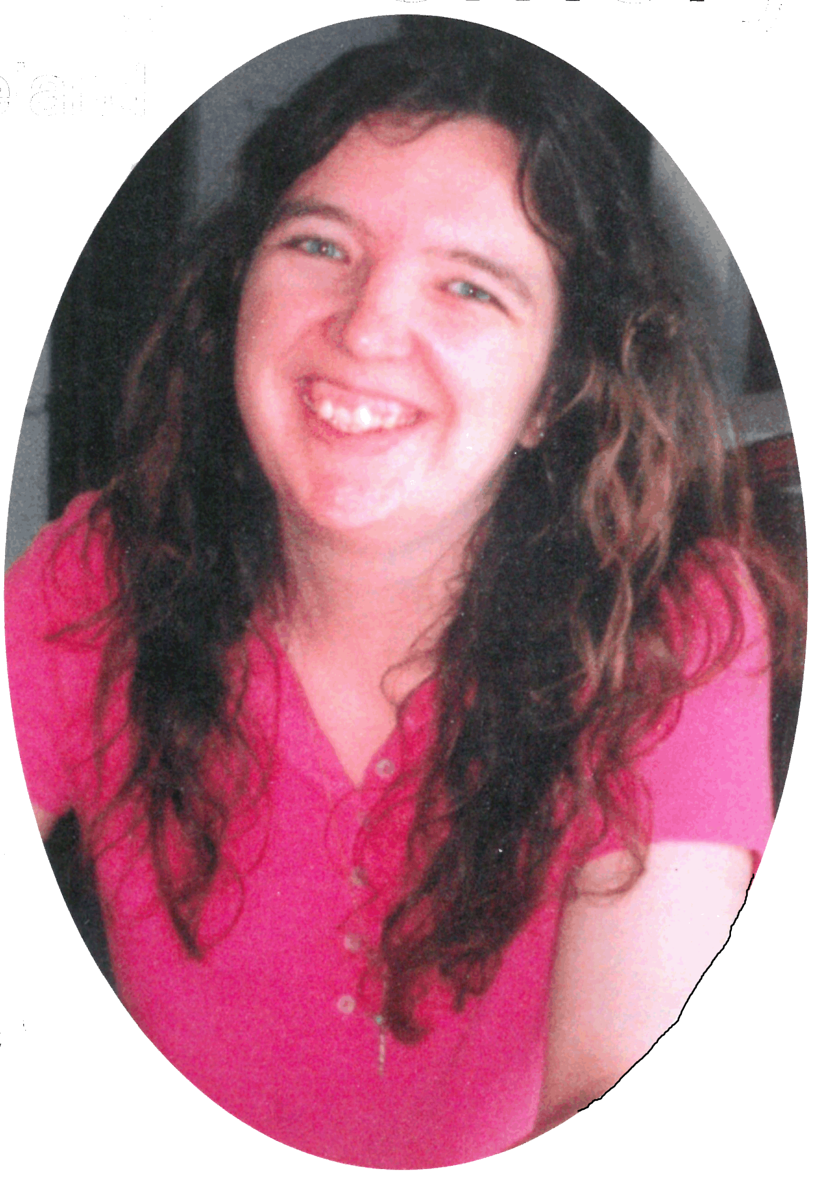
In Memory of Leah Marie Veland
Leah Veland had one dream after moving to Truman and attending St. Paul’s Lutheran School--she wanted to graduate from MLHS. Leah began her high school education at MLHS in September 1993 and became an involved and supportive student. She fulfilled her dream in 1997 as an excited, happy graduate of MLHS.
August 14, 1978
April 10, 2009

Slide 50
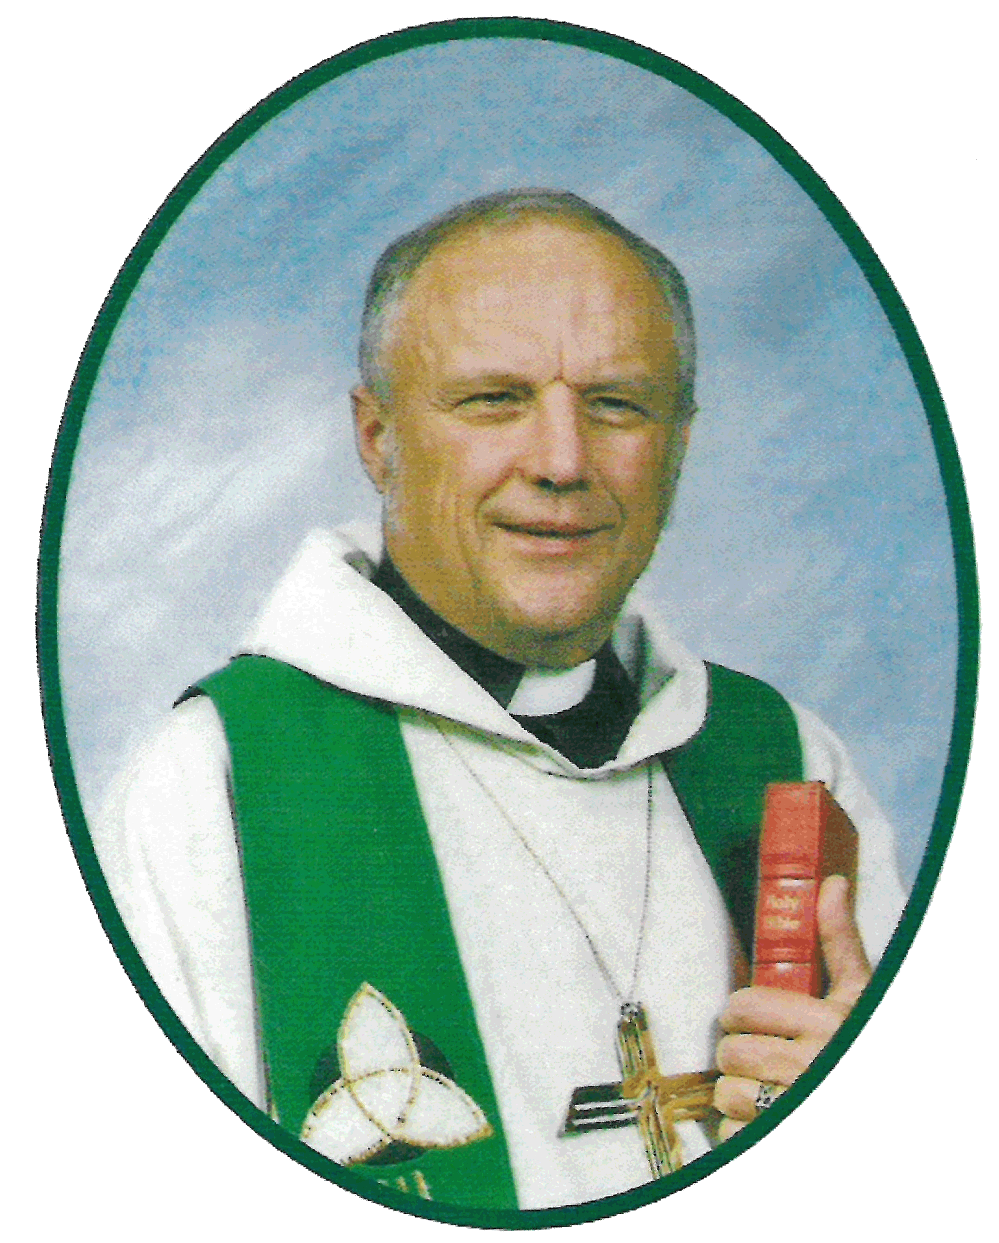
In Memory of Rev. Larry A. Veland
Rev. Veland served as pastor at St Paul’s Lutheran,
Truman from 1986 to 1997.
He had a heart for Christian
education and evangelism.
He supported MLHS in many ways. Some may remember the bright green cowboy hat he wore when auctioneering at MLHS fundraising events.
March 19, 1948
September 27, 2003

Slide 51
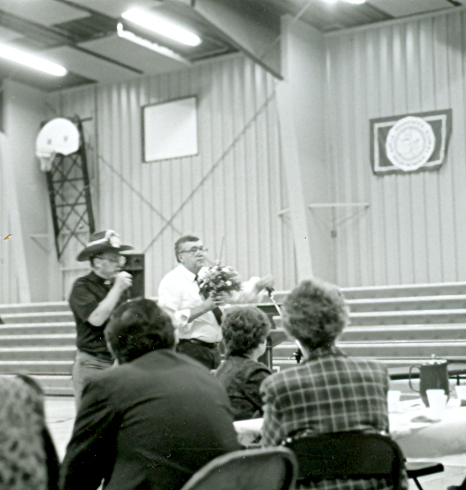
1988
Rev. Larry Veland (left) and Marty Krause auctioneering at the LEA Banquet

Slide 52
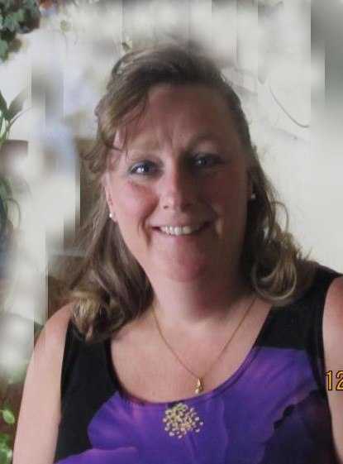
In Memory of Lori Ann Wiederhoeft
Lori Ann was a member of the first graduating class—The Class of 1986.
“Lori had a strong faith that was developed when she attended Martin Luther High School in Northrop,” said her sister, DeeAnn Britton.
March 11, 1968
February 16, 2018

Slide 53
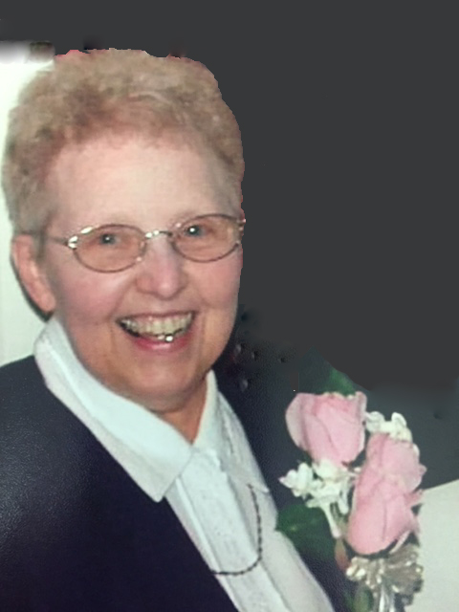
In Memory of Joanne Weihe
Joanne’s husband, Henry, was a founding member of Board of Directors. Together they worked with others to begin MLHS. Joanne helped to recruit the first teachers and worked to get the school building ready for the first year of classes. She was also a Guardian Angel tuition donor for many years. Daughter, Julie, graduated in 1987. Grandchildren who attended MLHS were Brandi (03), Parker (10), Tanner (13) and Alex (15). Joanne was a faithful volunteer throughout her lifetime.
September 27, 1938
May 5, 2010

Slide 54
In Memory of Tory Weihe
Tory was very strong in his faith, which is what lead him and wife, Jill, to decide to send Alex to MLHS before he passed away. Unfortunately, he passed away before
Alex started high school and wasn't able to physically be a part of MLHS. His strong faith and family values helped Alex be a successful MLHS graduate in 2015.
September 19, 1965
May 5, 2011

Slide 55
Joanne and Tory Weihe

Slide 56
In Memory of Delores (Lange) Wolle
Delores was an enthusiastic supporter of MLHS and volunteered often. She enjoyed attending the events that her grandchildren Lindsey (Halverson) O’Loughlin (99) and Lance Halverson (05) participated in.
December 28, 1935
October 20, 2012

Slide 57
Thank you to the families who have purchased a leaf on the Memory Tree to remember the pioneers who devoted so much to the MLHS Ministry.

Slide 58
In Memory of Ronald J. Royuk
Ron Royuk was the second Administrator at MLHS. He is pictured at left with his wife, Elaine.
Ron served MLHS from 1995 to 2003.
His theme through life was “God is good, all the time. All the time, God is good.” Praise the Lord.
June 17, 1941
Aug. 15, 2016

Slide 59
In Memory of
Rev. Dr. Arthur & Virginia Drevlow
From its beginning, the Drevlows were very supportive of Martin Luther High School. Reverend was instrumental in promoting the idea of a Lutheran high school in South Minnesota. They both believed in the importance of Lutheran Christian education, encouraged various students to attend MLHS, and supported the ongoing work of the school both financially and through their own work on its behalf. They would be pleased to know that Martin Luther continues to offer a Christ-centered education to the students and churches in southern Minnesota.

Slide 60
In Memory of Lorine Harley
Lorine M. Harley
March 22, 1916-December 6, 2014
Mrs. Harley was a loyal supporter of Lutheran education for all ages and was a faithful volunteer at St Paul Lutheran School, Fairmont and MLHS. Both Rev. and Mrs. Harley gave generously of their time, talents and treasures to grow God’s Ministries.

Slide 61
In Memory of Melvin Logemann
Melvin was a kind, caring man who gave generously to his church and to Martin Luther High School. He remembered MLHS with a large estate gift. One of his greatest pleasures was “running up the bids” at the Dinner Auction—whether it was for sky diving or Packer tickets. He enjoyed loving, living and giving.
1918-2013

Slide 62
The Vision of
Martin Luther High School
is to be an exemplary
Lutheran Educational Ministry.

Slide 63
MLHS Mission Statement
Martin Luther High School,
empowered by the
Gospel of Jesus Christ
in partnership with family
and congregations,
provides Christ-centered training
and nurturing
to help young people
excel academically
and
lead active Christian lives.

Slide 64
The MLHS Class of 2018
Four hundred eighty graduates have stepped out into the world empowered with the blessings that only a Christian high school education can give.

Slide 65
For I know the plans I have for you, declares the Lord, plans for welfare and not for evil, to give you a future and a hope. –Jeremiah 29:11

